Slide 1
Agricultural Drains, Part 3
In-Class Task Script
CE En 547
Brigham Young University

Slide 2
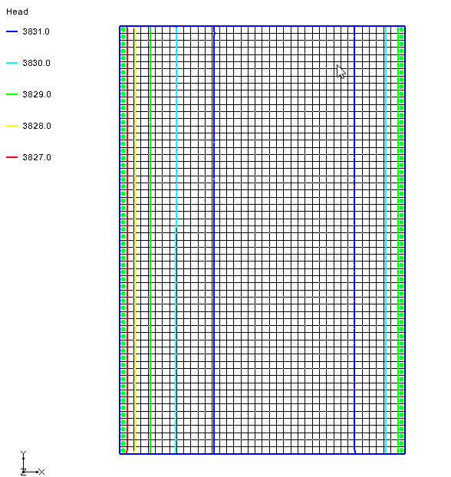
1. Open project in GMS

Slide 3
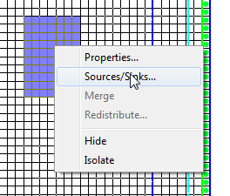
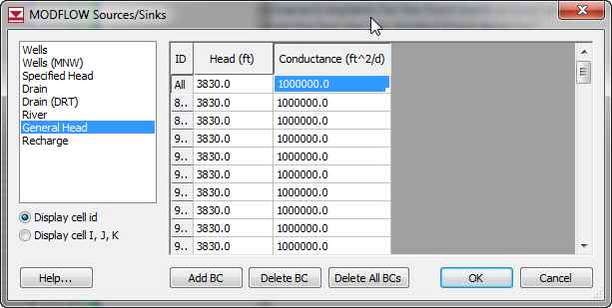
1. Select cells and mark as GHB

Slide 4
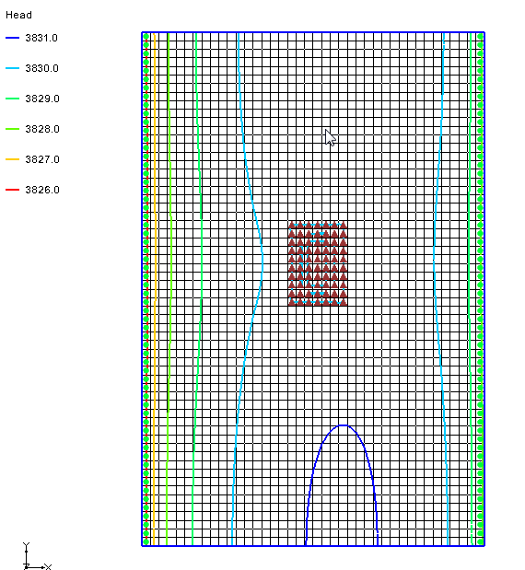
2a. Save and run
Note changes in head. Pond acts as a sink.

Slide 5
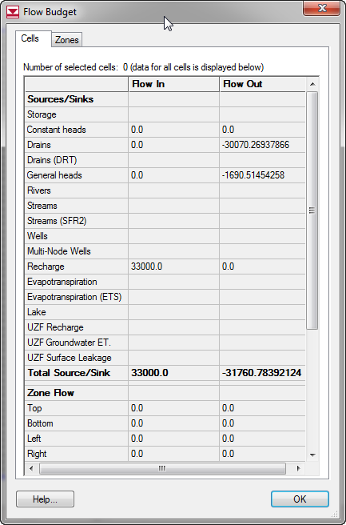
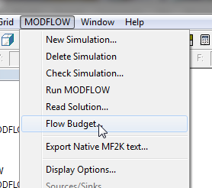
2b. Flow Budget
Is the pond a source or a sink?
How would spec head cells compare in this case?

Slide 6
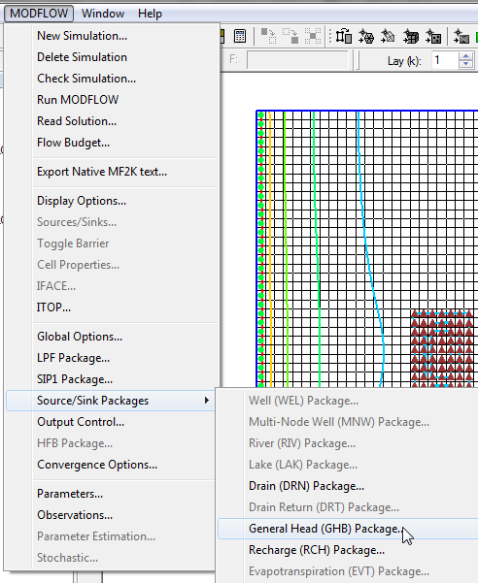
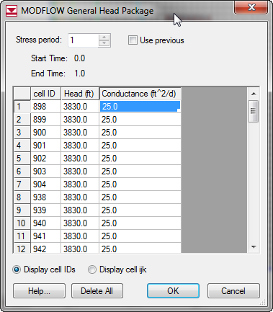
3a. Change conductance
Cell size = 50 ft x 50 ft
C =KA/L = (0.01)(50*50)/1
C = 25

Slide 7
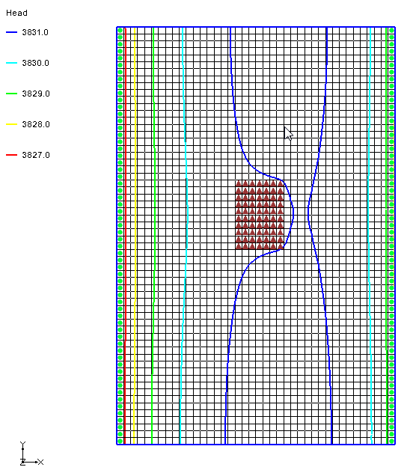
3b. Save and run
Heads are higher.
Why?

Slide 8
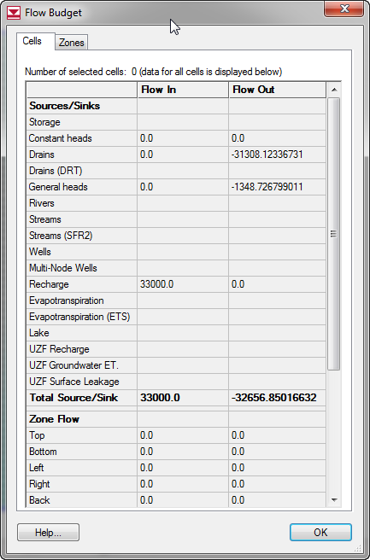
3c. Flow Budget
Less discharge to pond.
Why?

